Slide 1
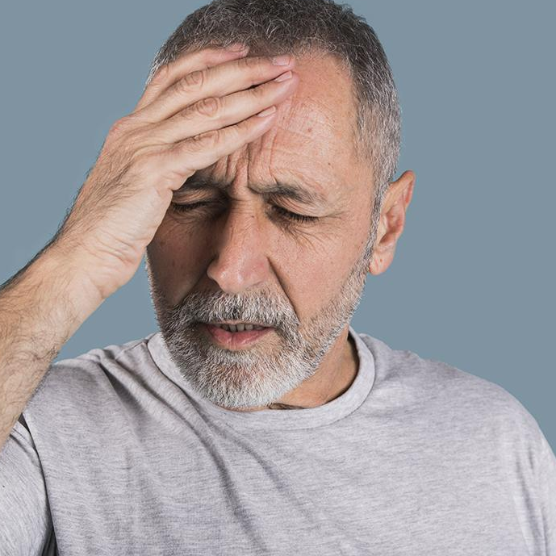
Stroke Prediction Analysis - AMISHA GUPTA (001559119)

Slide 2
Table of Contents
1
2
3
4
Overview
Analysis of Data
Introduction about stroke
Factors used for predicting stroke
Steps
Machine learning models
Steps followed for predicting stroke
Various machine learning algorithms and their results

Slide 3

Introduction
Stroke is a medical condition where the blood supply to part of your brain is reduced, preventing brain tissue from getting oxygen and nutrients
According to the statistics someone in the United States has a stroke every 40 seconds and every 4 minutes, someone dies of stroke.

Slide 4
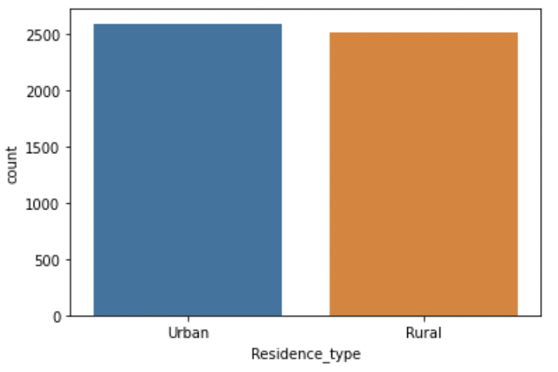
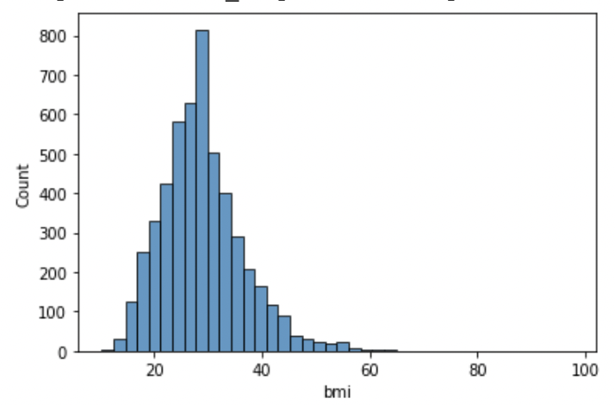
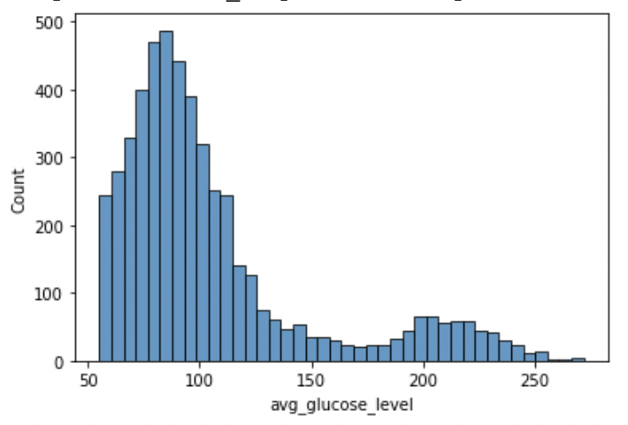
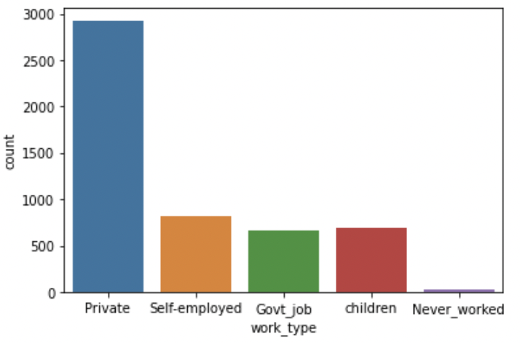
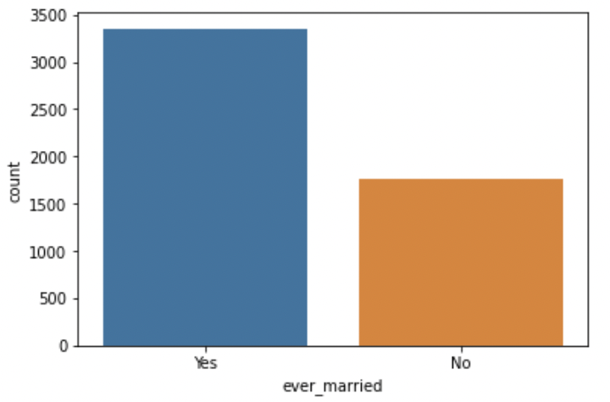
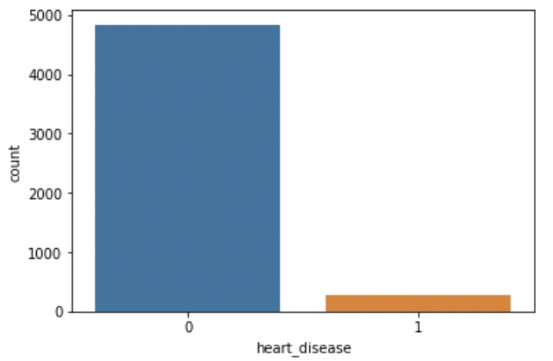
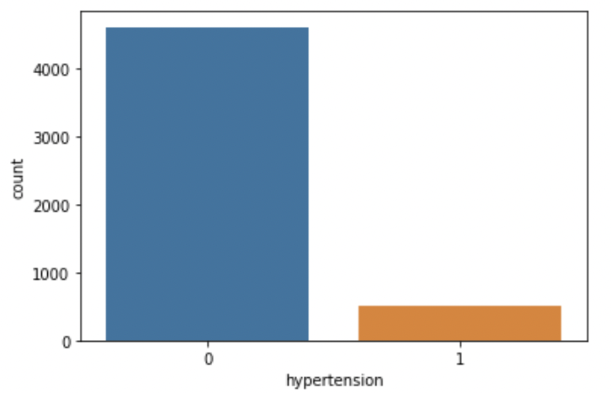
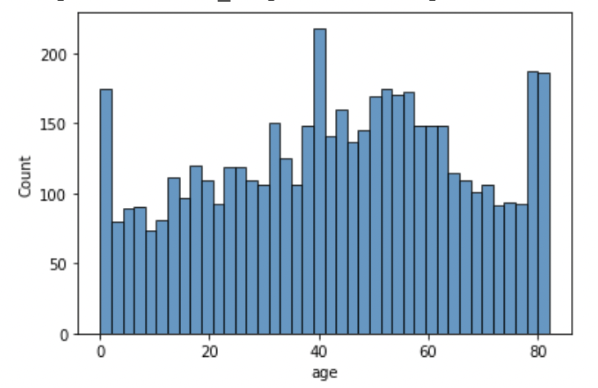
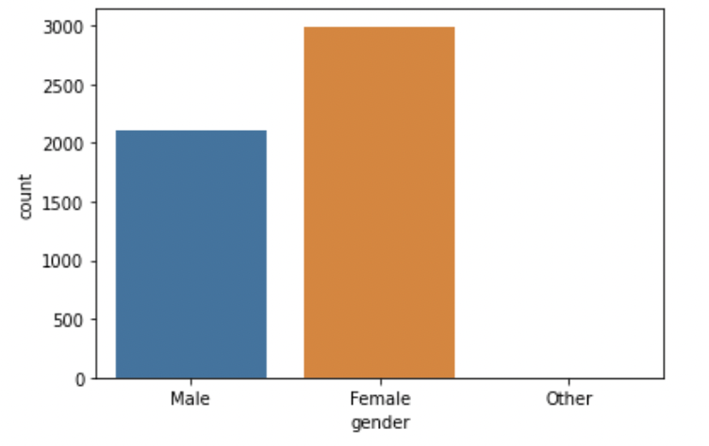
Analysis of Data

Slide 5
Steps
1
Reading data into Notebook
2
Data Imputation for missing values
3
One Hot encoding for categorical data
4
5
Train, Valid ,Test Splitting of data
6
Data Standardization- Scaling the data
Applying Machine learning models & Hyperparameter tuning
7
Testing the model through test dataset

Slide 6
Machine learning Models
Random Forest: The random forest is a classification algorithm consisting of many decisions trees. It uses bagging and feature randomness when building each individual tree to try to create an uncorrelated forest of trees whose prediction by committee is more accurate than that of any individual tree.
Decision Tree: Decision trees are constructed via an algorithmic approach that identifies ways to split a data set based on different conditions. It is one of the most widely used and practical methods for supervised learning. Decision Trees are a non-parametric supervised learning method used for both classification and regression tasks.
K nearest neighbor : KNN works by finding the distances between a query and all the examples in the data, selecting the specified number examples (K) closest to the query, then votes for the most frequent label (in the case of classification) or averages the labels (in the case of regression).

Slide 7
Results
 | Accuracy Score
Random Forest | 0.9422
Decision Tree | 0.9393
K nearest neighbor | 0.9412

Slide 8
References
Understanding Random forest - https://towardsdatascience.com/understanding-random-forest-58381e0602d2
Machine Learning Basics with the K-Nearest Neighbors Algorithm - https://towardsdatascience.com/machine-learning-basics-with-the-k-nearest-neighbors-algorithm-6a6e71d01761
Decision Tree in Machine Learning - https://towardsdatascience.com/decision-tree-in-machine-learning-e380942a4c96

Slide 9
THANK YOU

